Slide 1
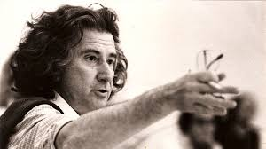
Theatre of the Oppressed
Cultural and historical background

Slide 2
This session will cover:
Introduction to Theatre of the Oppressed (TOTO)
Biographical and contextual details about Augusto Boal
Influences on Boal’s philosophy
The Poetics of the Oppressed
Main aim of Theatre of TOTO
Actors and non-actors
Role of the spect-actor
Role of the Joker

Slide 3
Introduction to TOTO

Slide 4
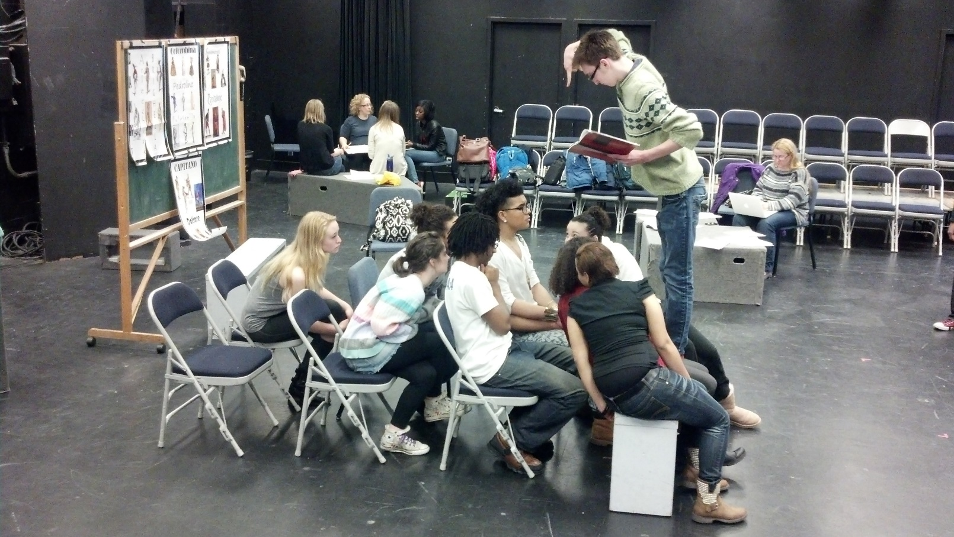
What was that?
Based on your prior knowledge and the clip that you just saw, what do you think TOTO is about?

Slide 5
What was that?
Basic principles of TOTO
Gives a voice to those members of society who do not have one
Help engage the audience in learning about ways to overcome oppression
Engage the audience in the creation of theatre
Presents a certain view of the world which allows others to then attempt to change it

Slide 6
Who is Augusto Boal
From the end…

Slide 7
Augusto Boal - Biography
Raised in Rio de Janerio, Brazil
Early work with the Arena Theatre in Sao Paulo led his experimentation with new forms of theatre
Because TOTO allowed civilians to have a voice and question social rules, Boal drew attention as a cultural activist and, in 1971, was kidnapped and exiled to Argentina

Slide 8
Brazilian Military Government
http://study.com/academy/lesson/military-rule-democratic-reform-in-brazil.html
Authoritarian military dictatorship that ruled Brazil from April 1, 1964 to March 15, 1985.
Enacted a new and restrictive Constitution which stifled freedom of speech and political opposition.
Censored all media (including theatre) and tortured and banished dissidents (such as they viewed Boal because of his Theatre of the Oppressed).

Slide 9
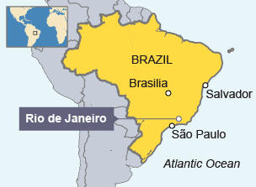

Slide 10
Augusto Boal & Theatre of the Oppressed
TOTO was established in the early 1970’s by Boal
A participatory theatre which fosters democratic and cooperative forms of interaction among participants
Here, theatre is emphasised not as a spectacle but rather as a language accessible to all
A type of theatre that allows people who are oppressed to learn ways of fighting back against oppression in their daily lives
Forum Theatre, Image Theatre and Invisible Theatre are the major parts of Theatre of the Oppressed

Slide 11
Augusto Boal & Theatre of the Oppressed
While exiled in Argentina, Boal developed Invisible Theatre to get around the repressive political climate.
Overall, Boal used TOTO to transform the “monologue” of the traditional performance into a “dialogue” between the audience and the stage.
SPECT-ACTOR → Boal defined the audience members who participate in TOTO as ‘spect-actors’. A process whereby audience members could stop a performance and take over from an actor playing a particular character/role and try out alternative strategies to resolve issues of oppression.

Slide 12
Role of the Joker
Much of Augusto Boal's theatrical process requires a neutral party to be at the centre of proceedings. This individual is usually called the "facilitator". In Boal's literature this role is referred to as the "joker", in reference to the neutrality of the Joker card in a deck of playing cards.
In most cases, but not all, this would be a drama workshop leader. This person takes responsibility for the logistics of the process and ensures a fair proceeding, but must never comment upon or intervene in the content of the performance, as that is the province of the "spect-actors".

Slide 13
Boal’s Influences
Most of Augusto Boal’s techniques were created after he realized the limitations of didactic, politically motivated theatre in the poor areas where he worked.
He found that his attempts to inspire the people living in poor or "slum" areas to rise up against racial and class inequality were inhibited by his own racial and class background, since he was white and comparatively financially comfortable.
His new techniques allowed the idea for change to come from within the target group – the group experiencing the particular type of oppression.

Slide 14
Boal’s Influences
Hegel’s Theory of Tragedy
Through the action of the tragic hero the main institutions of ethical life, the family and the state, come into conflict. In Hegel’s view the essence of tragedy is conflict, not a moral conflict between right and wrong, but a conflict between legitimate rights and institutions.
Brecht – Epic Theatre
Not allowing the audience to become passive observers and consumers of theatre and, as a result, adding to the social and cultural oppression.
Raising awareness of social and cultural issues, though Boal goes a step further and actually makes the spect-actor try to resolve the issues that are presented.

Slide 15
Homework
You should now be able to complete pp.7-17 of your activity booklet

