Slide 1
The Arsenal of the Oppressed
Structure of the Actor’s Work

Slide 2
This Session:
The Primacy of Emotion
Will/Counter-Will
Dangers of Mechanised Body
Dynamising the Senses

Slide 3
Terms
Arsenal: an array of resources available for a particular purpose – the actor training exercises linked de-mechanisation and dynamising the senses
Exercises: activity to develop acting skills
Games: an activity designed for fun and social interaction
Gamercise: combination – a game designed for fun which develops a specific acting skill and/or serves a social purpose in the preparation of spect-actors before participating in Theatre of the Oppressed

Slide 4
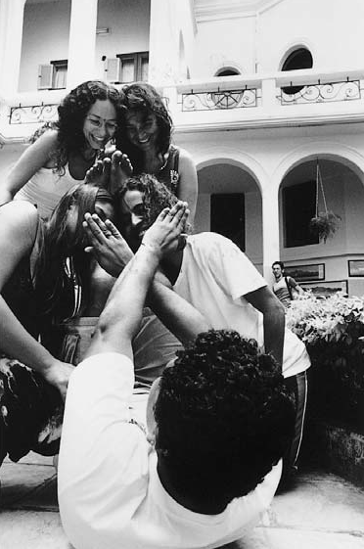
The Primacy of Emotion
How can emotions freely manifest themselves in actor’s body in ways that suit the character and engage the audience?
Often our bodies are, the actor’s instrument, is mechanised into certain methods of completing particular actions
Our body is “automated in its muscle structures and insensible to 70% of its possibilities” (Boal, 29)
New emotions of a character become ‘petrified’ – stuck in one form of expression based on the mechanisation of the actor’s body.

Slide 5
Gamercise Designed to De-Mechanise the Body

Slide 6
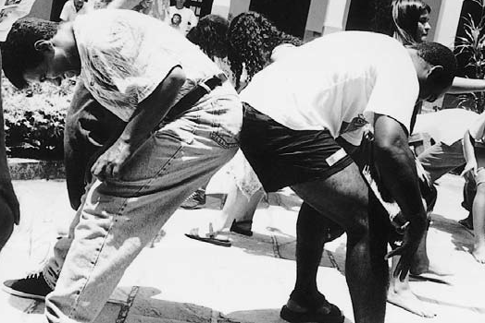
De-Mechanisation
Mechanisation is caused by repetition and categorisation
The eye sees colour and all shades of green are referred to as green
When confronted with similar situations we react and respond in the same way
De-mechanisation is the returning, the de-tuning of the actor so that they can take on the mechanisations of the character rather than the actor.

Slide 7
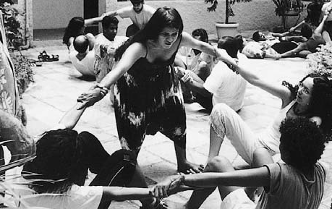
Exercises for De-Mechanisation
Before de-tuning, we must firstly be ware of how our bodies are mechanised in the first place.
Muscular Exercises
Awareness of how the muscles respond and behave when completing even simple actions
Sensory Exercises
Awareness of what senses are evoked when performing actions – e.g. tasting honey as opposed to vinegar – mime the physical responses to this
Memory Exercises
Remembering details, often done in groups when remembering details of events and seeing what differences arise and discussing why

Slide 8
Will & Counter-Will
Will:
the main objective and desire of the character
Counter-will:
competing interests of the character
Together these make a dynamic and engaging character
E.g. Hamlet wants only one thing, to avenge his father – but on the other hand he doesn’t want to kill his uncle. He wants to be and not to be.

Slide 9
The Will
The fundamental concept for the actor is not the ‘being’ of the character, but the ‘will’.
Stanislavskian links to units of action, objectives, counter-objectives and super objectives
Who is this?
Leads to stale and on dimensional characters and emotions
What do they want?
Leads to a dynamic, dialectical, conflicting, engaging and highly theatrical character
Character has a desire that they then attempt to fulfil

Slide 10
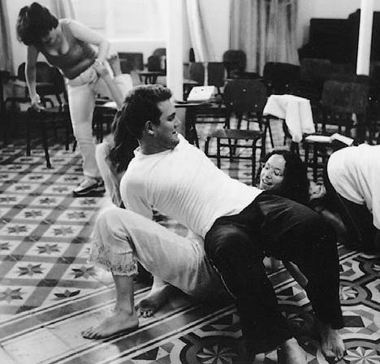
The Counter-Will
No emotion is pure or constant in quantity or quality – we have a mix of emotions which are always bubbling away at different levels
We want and we don’t want, we love and we don’t love, we’re brave and we’re not…
For the actor to truly live on stage they must find this counter-will
It enables effective conflict to be developed which allows focus and tension to developed
Counter-will must be USED at all times even if not visible to the audience

Slide 11
Hamlet – Confused Man

Slide 12
The Dominant Will
W+CW=DW
Will + Counter Will = Dominant Will
“From the interior conflict between the will and the counter-will there always emerges, on the exterior, a dominant will, which is the manifestation of the will in conflict with other characters” (Boal, p.45)
“In different versions of the same play, each character’s dominant will naturally depends on the central idea imposed on the particular version” (p.45) → The Directorial Concept will affect the wills of the characters and, therefore, the manifestation / expression of the wills.

Slide 13
Quantitative and Qualitative Variation
Quantitative
actions and events that add to the character’s will or counter-will
Qualitative
Actions or events that alter the will of the character

Slide 14
Dangers of a Mechanised Body
“Emotion took precedence over all else and should be given a free rein to shape the final form of the actor’s interpretation of the role” (Boal, p.29)
A mechanised body means actors have automated expression of emotion
By de-mechanising the body a much vaster array of characters can be performed because actors have more control and ability to manipulate their bodies in different ways

Slide 15
Dynamising the Senses
Boal intended for the actors to be able to dynamise the senses
Make use of all their senses in order to effectively express character
This relies on the de-mechanised body in order to seek new and meaningful ways to utilise the senses
Feeling What We Touch (the cross and the circle, Colombian hypnosis, pushing against each other, trust circle)
Listening To What We Hear (a round of rhythm movement, the machine of rhythms, the Peruvian Ball Game)
Seeing What We Look At (mirrors – everyone joins hands, modelling – sculptor with 5 or more models, string puppet, fear and protector, building character relations, complete the image)

Slide 16
Where You Should Be…
Finish up to p.21
Primacy of Emotion and De-Mechanisation of the Body
The Will/Counter-Will
Dynamising the Senses
Read the book – taylorlhs.weebly.com

