Slide 1
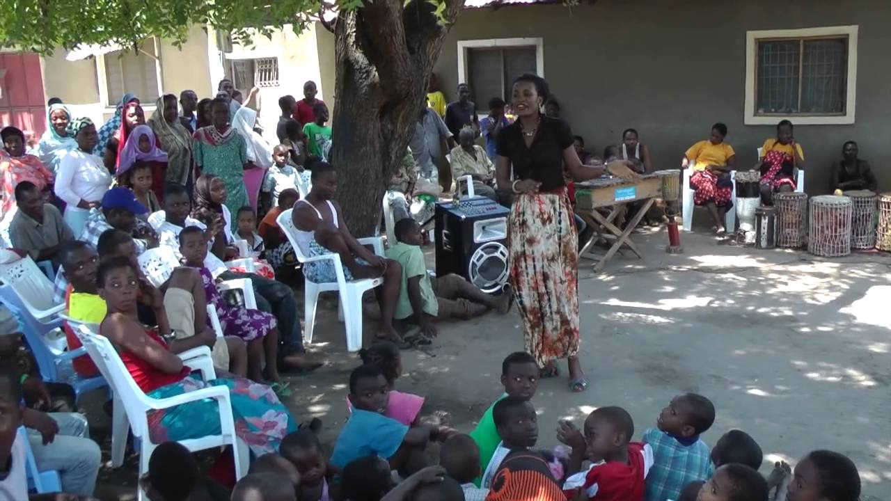
Forms of Theatre of the Oppressed
Image Theatre ~ Forum Theatre ~ Invisible Theatre

Slide 2
What You Should Know:
The purpose of all forms of Theatre of the Oppressed for:
The spect-actor
The actor
The conventions and rule of Image Theatre, Forum Theatre and Invisible Theatre
The role of the actor, the non-actor, and The Joker in all forms of TOTO

Slide 3
Image Theatre
“words are only vehicles which convey meanings, emotions, memories, ideas…which are not necessarily the same for everyone: the word spoken is never the word heard.” (Boal, p.174).
Images do not replace words but they can translated into words of many languages – the images are a universal language in themselves (p.175).
Early on, when dealing with only simple frozen images, Boal called this Statue Theatre.
“Later on, new techniques [were used] in which movement was added, then even words…this became Image Theatre.” (p.175).

Slide 4
Image Theatre
Dealing with images we should try NOT to ‘understand’ the meaning of each image…but to feel those images.
Images will mean something different to everyone looking at it depending on their context.
If an image is interpreted as meaning only one thing then it is an illustration of words; the image should provoke thought!

Slide 5
Image Techniques: Models and Dynamisations
THE MODEL
The Joker works with the group to agree upon a theme of oppression
Each individual, in turn, present their image of this oppression – no comments should be made as this is their opinion
1st Dynamisation
Each actor enters the space together and presents their image again
We have now moved from separate and individual representations of the oppression to a more social view, though still with multiple perspectives

Slide 6
Image Techniques: Models and Dynamisations
2nd Dynamisation
On the Joker’s signal all participants start to interrelate with the others in the space
3rd Dynamisation
Very often the participants will show the victims of oppression (because this is generally who Boal was working with)
In this dynamisation, the participants are asked to create an image of the origin of their oppression as opposed to the effect…cause & effect are two important concepts for the actors and spect-actors to understand

Slide 7
Forum Theatre
Boal was heavily influenced by Brecht’s technique of alienation and Epic Theatre, where the audience was removed from the idea of ‘watching’ and, instead, were forced to consider the social issues being presented.
Forum Theatre took this a step further and asked the spect-actors to engage in the issue, to take action in attempts to remove oppression from the issue presented to them.
The goal of Forum Theatre was not to fix the world; it aimed to broaden perspectives and teach possible strategies that could be used in the real world.
FORUM → a meeting or medium where ideas and views on a particular issue can be exchanged.

Slide 8
Rule of Forum Theatre
Actors must portray real and clear characters – they must have strong will, counter-will, relationships, status and the location must be clearly defined.
The play must have at least one very well-defined social or political ‘error’ which can be analysed during the forum session.
The play can be in any style or genre except surrealism – style does not matter as long as the objective is to discuss concrete situations (Boal, p.242).

Slide 9
Staging Forum Theatre
The play should be rehearsed and performed like any conventional play – it must be a high quality performance in and of itself.
Actors must physicalise their characters’ ideology, work, social function, profession, etc.
Each character must be presented visually, in such a way as to be recognisable independently of the spoken script.

Slide 10
Performing Forum Theatre
Show performed like a conventional play – a certain vision of the world is presented;
The spect-actors are asked if they agree with what has happened, a forum is held and the issues are discussed;
The play is performed again, this time the spect-actors can call “stop” and take the place of a character on stage from a moment they would like to change;
The actor who has been replaced stays on the sideline, providing suggestions and stimulating the scene if needed;
From the moment the spect-actor take over from, all other actors become agents of oppression – or more so if they already were. The aim of “is not to win, but to learn and train…for ‘real life’ action” (p.244).
The scene will come to a logical conclusion – with a solution or not – and the spect-actors and the actors should all partake in a dialogue, led by the Joker, to discuss what strategies were tried and how they were useful.

Slide 11
Invisible Theatre

Slide 12
Invisible Theatre
The actors do their job;
The audience do not know they are watching theatre
“Invisible Theatre is theatre; it must have a text with a scripted core, which will inevitably be modified, according to the circumstances, to suit the interventions of the spect-actors” (Boal, p.277).
The chosen subject must be an issue of burning importance! The spect-actors should be aware of, and recognise, the social or political issue being presented.

Slide 13
The Joker
Forum theater is facilitated by someone called a Joker, who engages the spect-actors both on and off stage in dialogue throughout the process. After an intervention, the Joker may ask, “Did this work?”, “Was this realistic?”, “Can you do this in real life?”
The role of the Joker is a tricky one. It is easy to leave the group with false optimism about what can work, or to run out of time before everyone is satisfied with what has been attempted. The Joker must make many small decisions in every moment, such as whether or not to allow the introduction of additional characters, whether or not to add interventions upon other interventions, how many interventions to allow, when to stop an intervention when it’s not going anywhere, and so on.

Slide 14
Where You Need To Be:
Up to p.51 of booklet complete
Practice Essay on Boal completed and submitted

