Slide 1
Julie Taymor
Symbolism
Suspension of disbelief
ideograph

Slide 2
Symbolism
What is it?

Slide 3
Symbolism

Slide 4
Suspension of disbelief
Through symbolism, meaning is created.
Symbolism, in the theatre, allows for deep meaning to be communicated in simple and effective ways.
When the audience understands a complex concept through symbolism, they are suspending their disbelief:
E.g. “I know that is just a person wearing a red mask, but I understand that the person is representing all things evil”.

Slide 5
Suspension of disbelief
The term suspension of disbelief or willing suspension of disbelief has been defined as a willingness to suspend one's critical faculties and believe the unbelievable; sacrifice of realism and logic for the sake of enjoyment.
You need to direct your production with a particular style of theatre, or effecting combination of styles, to earn trust enough from the audience so that they are willing to suspend their disbelief and believe what you are presenting and representing.
How?
Design
Staging
Performance
Set
Props
Costume
And.............?

Slide 6
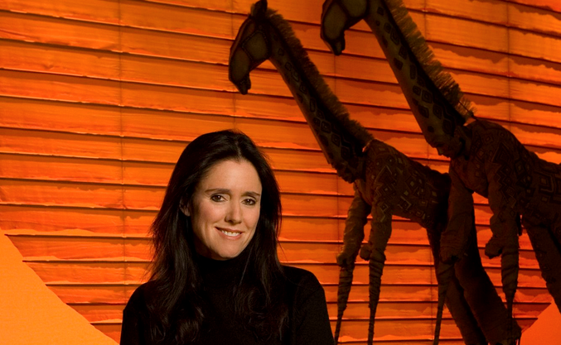
Julie Taymor
Born 1952, American stage and film director, playwright and costume designer.
Known for her inventive use of Asian-inspired masks and puppets.
First woman to win a Tony Award for best director in 1998.
Effectively utilises the concept of “the suspension of disbelief” by using visible puppeteers and masks.
Interesting concept of the ideograph used to stimulate a concept and the directorial process.

Slide 7
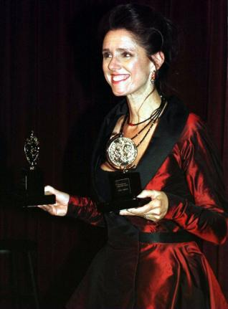
Julie Taymor
Experienced theatre director and has moved into the film industry also.
Has a keen interest in other cultures which influences her work.
Finished college in the 1970’s and travelled to Asia on a fellowship.
Established her own theatre company in Bali – Theatre Loh.
Stage that she was impressed by theater’s role in society there.
“I was very taken with the fact that the theatre productions there were a part of everyday life. . . . You don’t do it because . . .you’re going to be reviewed in Time magazine, but it’s part of what it is to be a living human being.”
Has one awards for scenic, costume and puppet design as well as directing.
Julie Taymor Biography, http://www.biography.com/people/julietaymor320722, March 23 2016.

Slide 8
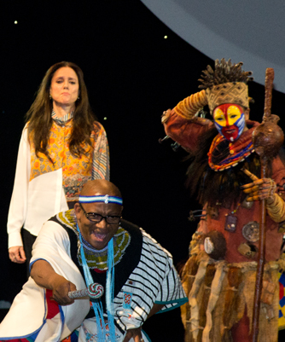
Julie Taymor
Spider-Man, Lion King and Life on the Creative Edge

Slide 9
Ideograph
A graphic symbol that represents an idea or concept

Slide 10
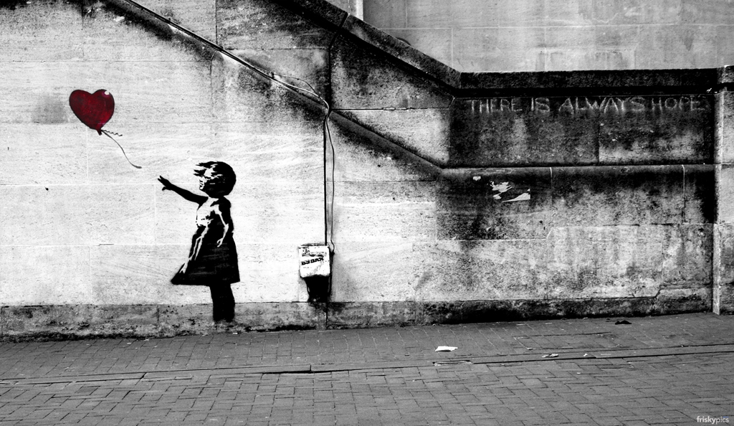
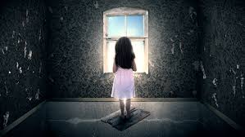

Slide 12
Note down important points about symbols...

Slide 13
In pairs...
You will be give Act 1, Scene 1 of The Tempest (William Shakespeare)
Consider how you can use strategies and techniques employed by Taymor in your conceptualisation of the scene.
Consider:
An ideograph that represents the story for you – how can this influence the overall design?
How can you use symbolism in a variety of ways? Set, lighting, costume...
Is there the potential of using masks and/or puppets to help communicate the original ideograph’s main message?
Your aim is to communicate meaning and have the audience suspend their disbelief.

