Slide 1
FROM OLD TO NEW

Slide 2
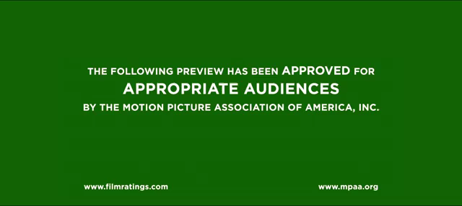

Slide 3
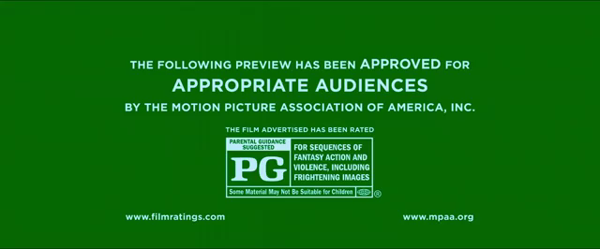

Slide 4


Slide 6
Movies? Traditional Story?

Slide 7
Appropriation
Appropriation is taking an image, character or technique from one context and placing it in another. This happens quite a lot in many written text forms. Often the appropriation will occur when a character is taken out of their time. Another form of appropriation is when the composer wants the audience to view the conventional text through an unconventional perspective. One example would be composing a fairytale where the story, usually told from the knight's point of view, is told from the dragon's point of view.

